Slide 1
Unit 2:
Rapid software development

Slide 2
Objectives
To explain how an iterative, incremental development process leads to faster delivery of more useful software
To discuss the essence of agile development methods
To explain the principles and practices of extreme programming
To explain the roles of prototyping in the software process

Slide 3
Topics covered
Agile methods
Extreme programming
Rapid application development
Software prototyping

Slide 4
Rapid software development
Because of rapidly changing business environments, businesses have to respond to new opportunities and competition.
This requires software and rapid development and delivery is not often the most critical requirement for software systems.
Businesses may be willing to accept lower quality software if rapid delivery of essential functionality is possible.

Slide 5
Requirements
Because of the changing environment, it is often impossible to arrive at a stable, consistent set of system requirements.
Therefore a waterfall model of development is impractical and an approach to development based on iterative specification and delivery is the only way to deliver software quickly.

Slide 6
Characteristics of RAD processes
The processes of specification, design and implementation are concurrent. There is no detailed specification and design documentation is minimised.
The system is developed in a series of increments. End users evaluate each increment and make proposals for later increments.
System user interfaces are usually developed using an interactive development system.

Slide 7
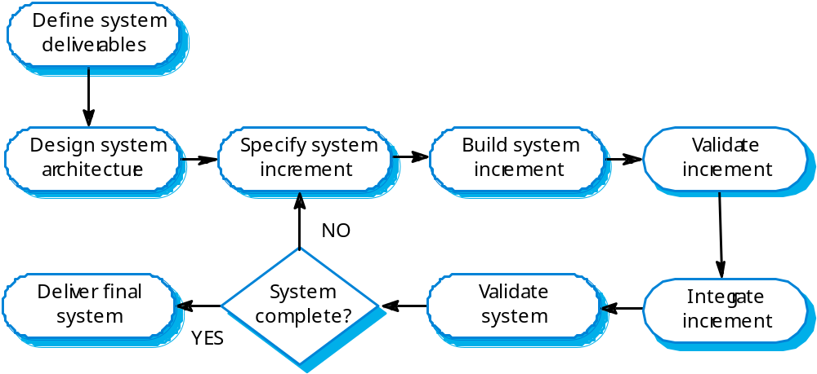
An iterative development process

Slide 8
Advantages of incremental development
Accelerated delivery of customer services. Each increment delivers the highest priority functionality to the customer.
User engagement with the system. Users have to be involved in the development which means the system is more likely to meet their requirements and the users are more committed to the system.

Slide 9
Problems with incremental development
Management problems
  Progress can be hard to judge and problems hard to find because there is no documentation to demonstrate what has been done.
Contractual problems
  The normal contract may include a specification; without a specification, different forms of contract have to be used.
Validation problems
  Without a specification, what is the system being tested against?
Maintenance problems
  Continual change tends to corrupt software structure making it more expensive to change and evolve to meet new requirements.

Slide 10
Prototyping
For some large systems, incremental iterative development and delivery may be impractical; this is especially true when multiple teams are working on different sites.
Prototyping, where an experimental system is developed as a basis for formulating the requirements may be used. This system is thrown away when the system specification has been agreed.

Slide 11
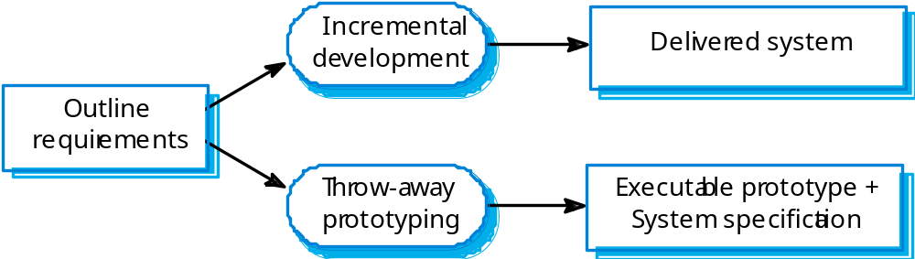
Incremental development and prototyping

Slide 12
Conflicting objectives
The objective of incremental development is to deliver a working system to end-users. The development starts with those requirements which are best understood.
The objective of throw-away prototyping is to validate or derive the system requirements. The prototyping process starts with those requirements which are poorly understood.

Slide 13
Agile methods
Dissatisfaction with the overheads involved in design methods led to the creation of agile methods. These methods:
  Focus on the code rather than the design;
  Are based on an iterative approach to software development;
  Are intended to deliver working software quickly and evolve this quickly to meet changing requirements.
Agile methods are probably best suited to small/medium-sized business systems or PC products.

Slide 14
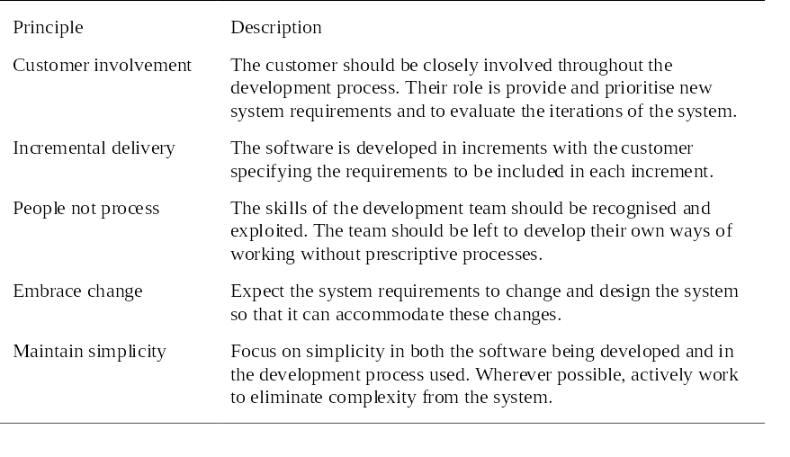
Principles of agile methods

Slide 15
Problems with agile methods
It can be difficult to keep the interest of customers who are involved in the process.
Team members may be unsuited to the intense involvement that characterises agile methods.
Prioritising changes can be difficult where there are multiple stakeholders.
Maintaining simplicity requires extra work.
Contracts may be a problem as with other approaches to iterative development.

Slide 16
Extreme programming
Perhaps the best-known and most widely used agile method.
Extreme Programming (XP) takes an ‘extreme’ approach to iterative development.
  New versions may be built several times per day;
  Increments are delivered to customers every 2 weeks;
  All tests must be run for every build and the build is only accepted if tests run successfully.

Slide 17
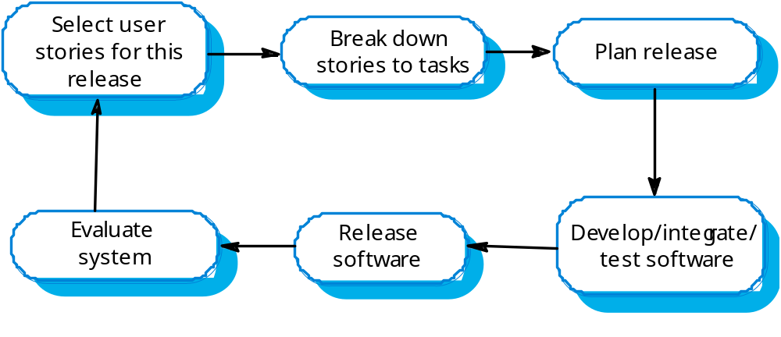
The XP release cycle

Slide 18
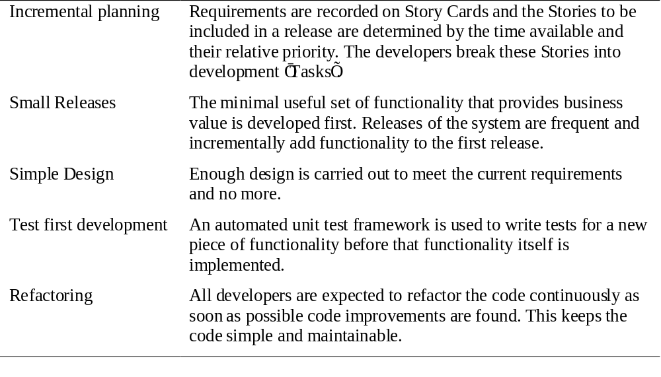
Extreme programming practices 1

Slide 19
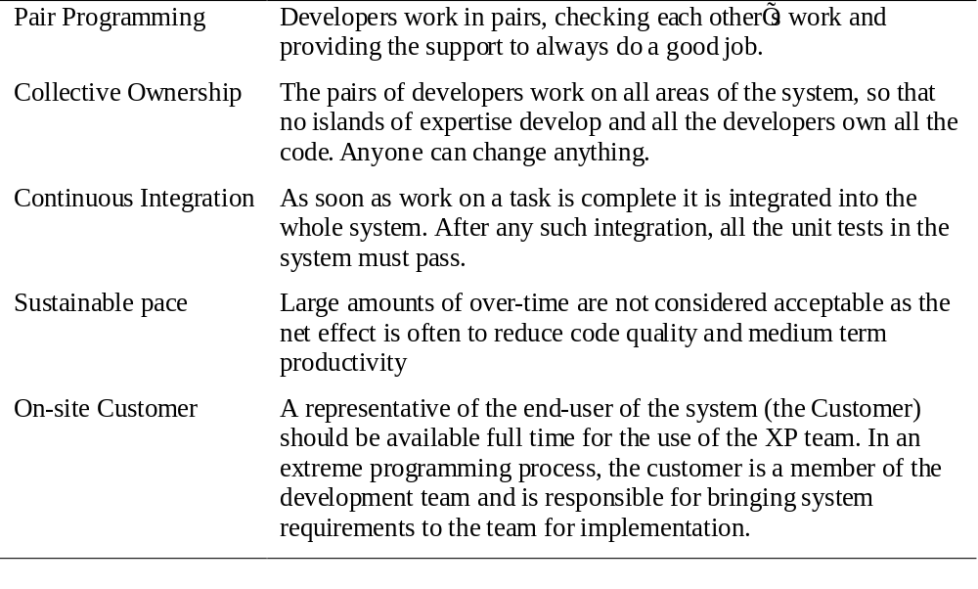
Extreme programming practices 2

Slide 20
XP and agile principles
Incremental development is supported through small, frequent system releases.
Customer involvement means full-time customer engagement with the team.
People not process through pair programming, collective ownership and a process that avoids long working hours.
Change supported through regular system releases.
Maintaining simplicity through constant refactoring of code.

Slide 21
Requirements scenarios
In XP, user requirements are expressed as scenarios or user stories.
These are written on cards and the development team break them down into implementation tasks. These tasks are the basis of schedule and cost estimates.
The customer chooses the stories for inclusion in the next release based on their priorities and the schedule estimates.

Slide 22
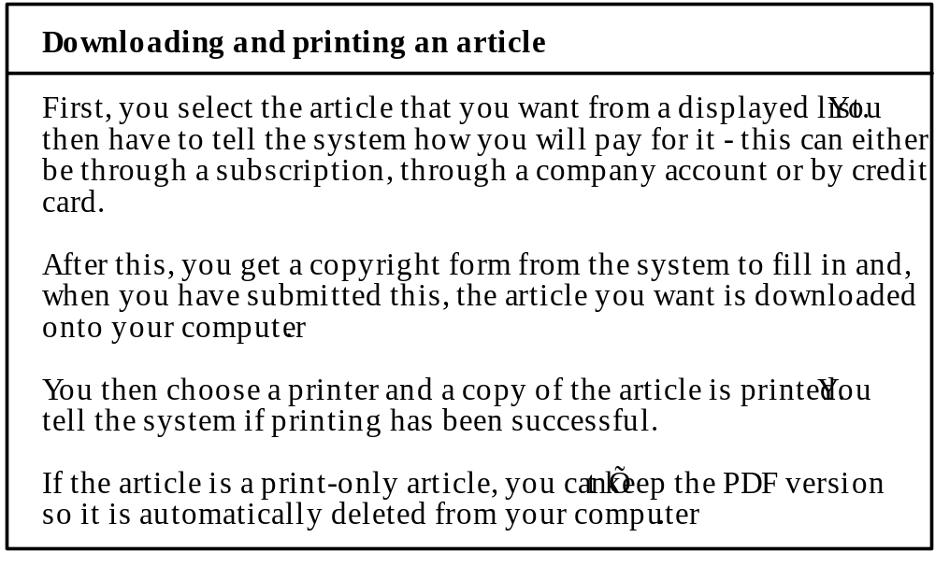
Story card for document downloading

Slide 23
XP and change
Conventional wisdom in software engineering is to design for change. It is worth spending time and effort anticipating changes as this reduces costs later in the life cycle.
XP, however, maintains that this is not worthwhile as changes cannot be reliably anticipated.
Rather, it proposes constant code improvement (refactoring) to make changes easier when they have to be implemented.

Slide 24
Testing in XP
Test-first development.
Incremental test development from scenarios.
User involvement in test development and validation.
Automated test harnesses are used to run all component tests each time that a new release is built.

Slide 25
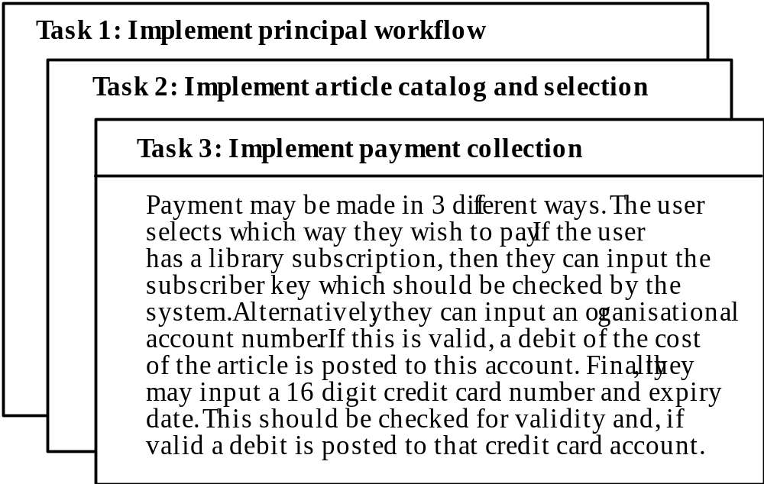
Task cards for document downloading

Slide 26
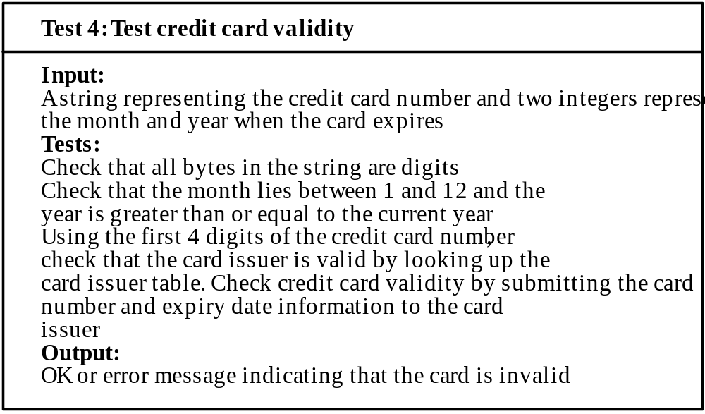
Test case description

Slide 27
Test-first development
Writing tests before code clarifies the requirements to be implemented.
Tests are written as programs rather than data so that they can be executed automatically. The test includes a check that it has executed correctly.
All previous and new tests are automatically run when new functionality is added. Thus checking that the new functionality has not introduced errors.

Slide 28
Pair programming
In XP, programmers work in pairs, sitting together to develop code.
This helps develop common ownership of code and spreads knowledge across the team.
It serves as an informal review process as each line of code is looked at by more than 1 person.
It encourages refactoring as the whole team can benefit from this.
Measurements suggest that development productivity with pair programming is similar to that of two people working independently.

Slide 29
Rapid application development
Agile methods have received a lot of attention but other approaches to rapid application development have been used for many years.
These are designed to develop data-intensive business applications and rely on programming and presenting information from a database.

Slide 30
RAD environment tools
Database programming language
Interface generator
Links to office applications
Report generators

Slide 31
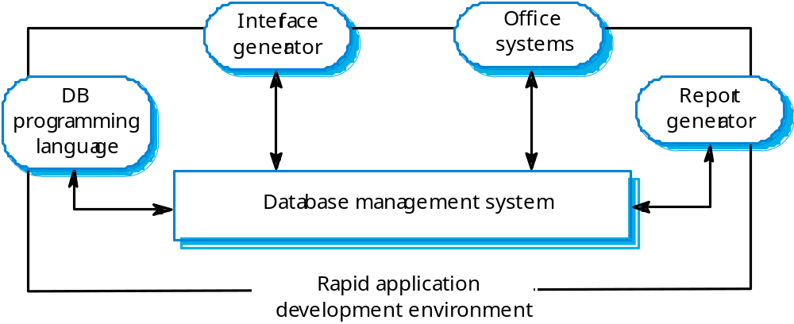
A RAD environment

Slide 32
Software prototyping
A prototype is an initial version of a system used to demonstrate concepts and try out design options.
A prototype can be used in:
  The requirements engineering process to help with requirements elicitation and validation;
  In design processes to explore options and develop a UI design;
  In the testing process to run back-to-back tests.

Slide 33
Benefits of prototyping
Improved system usability.
A closer match to users’ real needs.
Improved design quality.
Improved maintainability.
Reduced development effort.

Slide 34
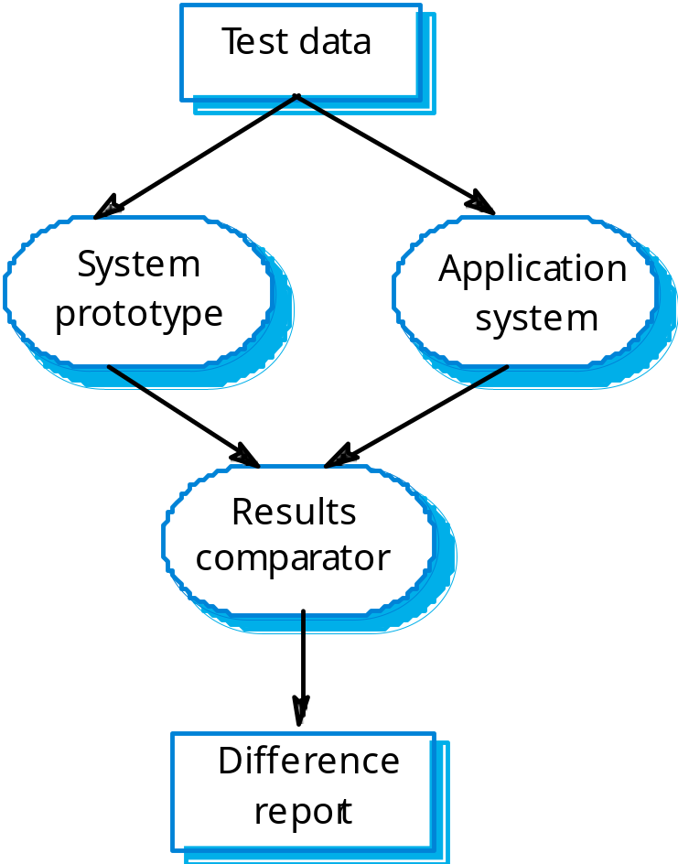
Back to back testing

Slide 35
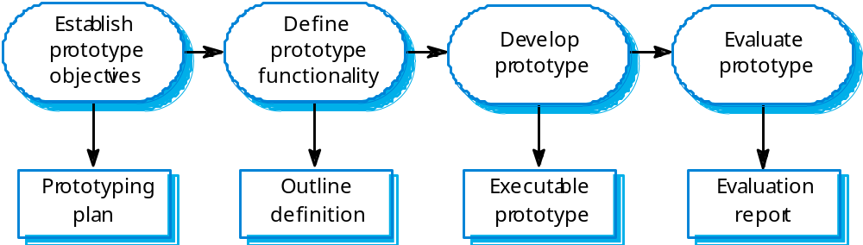
The prototyping process

Slide 36
Throw-away prototypes
Prototypes should be discarded after development as they are not a good basis for a production system:
  It may be impossible to tune the system to meet non-functional requirements;
  Prototypes are normally undocumented;
  The prototype structure is usually degraded through rapid change;
  The prototype probably will not meet normal organisational quality standards.

Slide 37
Key points
An iterative approach to software development leads to faster delivery of software.
Agile methods are iterative development methods that aim to reduce development overhead and so produce software faster.
Extreme programming includes practices such as systematic testing, continuous improvement and customer involvement.
The approach to testing in XP is a particular strength where executable tests are developed before the code is written.

Slide 38
Key points
Rapid application development environments include database programming languages, form generation tools and links to office applications.
A throw-away prototype is used to explore requirements and design options.
When implementing a throw-away prototype, start with the requirements you least understand; in incremental development, start with the best-understood requirements.

